Slide 1
Skin Cancer Detection
Dr. Ibrahim Zaghloul
Eng. Ahmed Yousry

Slide 2
Contents
01
02
03
04
05
Abstract
Proposed Work
Our Dataset
06
Introduction
Problem
CNN and TL Models
07
Conclusion

Slide 3
Abstract
Skin cancer is a major public health concern, and early detection is crucial for successful treatment. Deep learning models, such as convolutional neural networks (CNNs), have shown promising results for skin cancer classification based on images of the skin.
However, training deep learning models from scratch requires a large amount of labeled data and computational resources, which may not be readily available. Transfer learning is a technique that allows us to leverage pre-trained CNN models that have been trained on large image datasets, and adapt them to new tasks with smaller datasets.
In this project, we investigate the use of transfer learning models, such as VGG16, Xception, ResNet50, and InceptionV3, for skin cancer classification based on images of the skin.

Slide 4
We preprocess the images by resizing them to a uniform size, normalizing the pixel values, and augmenting the dataset using techniques such as rotation, and flipping.
We preprocess the images by resizing them to a uniform size, normalizing the pixel values, and augmenting the dataset using techniques such as rotation, and flipping.
We fine-tune the pre-trained models on the preprocessed images using techniques such as transfer learning, dropout regularization, and early stopping.
We evaluate the performance of the models using appropriate metrics, such as accuracy, precision, recall, and F1 score, and compare them to each other.
In our skin cancer detection project, we use various evaluation metrics and visualization techniques to assess the performance of our models. We use a confusion matrix and classification report to analyze the accuracy, precision, recall, and F1 score of our models. We also plot graphs for accuracy, loss, and area under the curve (AUC) to visualize the performance of our models over time.

Slide 5
These evaluation metrics and visualization techniques help us to identify the strengths and weaknesses of our models, and to make informed decisions about model selection and hyperparameter tuning.
Our results show that transfer learning models can achieve high accuracy, precision, recall, and F1 score for skin cancer classification, and that the performance of different models varies depending on the dataset and the task. We also show that the interpretability analysis can provide insights into how the models make decisions and identify the features that are most important for classification.
Overall, our study demonstrates the potential of deep learning models and transfer learning for skin cancer detection and provides insights into the interpretability of these models.

Slide 6
Proposed Work
The proposed approach can be deployed to assist dermatologists in skin cancer detection. Moreover, it can be applied in smartphones for self-diagnosis of malignant skin lesions. Hence, it may expedite cancer detection that is critical for effective treatment.
We Use CNN and Transfer Learning Models to solve our problem.

Slide 7
Our Dataset
Train Data
4625 For malignant
5020 For benign
Test Data
500 For malignant
500 For benign
Validation
Subset of Training Data (20%)

Slide 8
Introduction
Skin cancer presents unique challenges in terms of accurate diagnosis.
Even for experienced dermatologists, distinguishing between benign and malignant lesions can be complex and prone to errors.
This complexity arises due to variations in lesion appearances, overlapping characteristics with non-cancerous skin conditions, and the limited availability of expert dermatologists in certain regions.
Therefore, there is a pressing need for automated systems that can assist healthcare professionals in the early detection of skin cancer.

Slide 9
Introduction
Skin cancer is a serious health concern, and early detection is crucial for effective treatment.
With the use of combination CNN and transfer learning , an automated system can be developed that can accurately identify potential cancerous lesions from images, potentially saving lives and reducing healthcare costs.

Slide 10
The Role of Neural Networks in Skin Cancer Detection:
Neural networks, a branch of artificial intelligence, have shown remarkable capabilities in image recognition tasks.
Convolutional Neural Networks (CNNs) are particularly well-suited for analyzing visual data, such as skin lesion images.
By leveraging their ability to learn intricate patterns and features from vast amounts of data, neural networks have the potential to revolutionize the field of skin cancer detection.
They can aid in accurate diagnosis, assist dermatologists, and improve access to reliable skin cancer screening.

Slide 11
Problem
Skin cancer is a major public health concern and early detection is crucial for successful treatment.
However, accurate diagnosis of skin cancer can be challenging for clinicians, particularly for melanoma, which is the deadliest type of skin cancer.
In this project, we aim to develop a deep learning model that can accurately classify skin lesions as either malignant (cancerous) or benign
(noncancerous) based on images of the skin, using convolutional neural networks (CNNs) and transfer learning models.

Slide 12
CNN and TL Models :
CNN Model
ResNet50 Model
Xception Model
VGG16 Model
InceptionV3 Model
EfficientNetB2-B4 Model
DenseNet121 Model

Slide 13
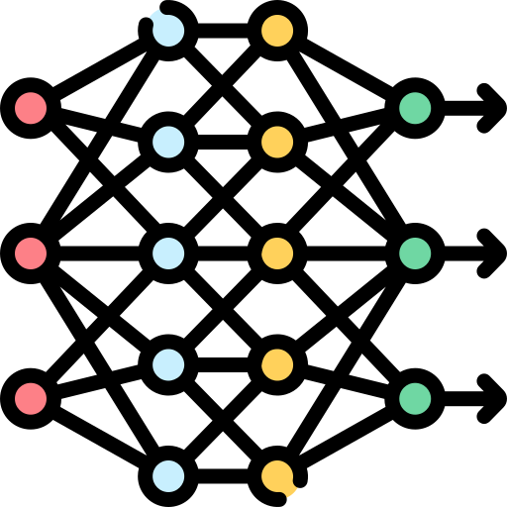
CNN Model
01
Training Accuracy
0.898
02
Training Loss
0.231
03
Evaluate Accuracy
0.913
04
Evaluate Loss
0.230

Slide 14
Xception Model
01
Training Accuracy
1.000
02
Training Loss
1.452e-04
03
Evaluate Accuracy
0.912
04
Evaluate Loss
0.665

Slide 15
InceptionV3 Model
01
Training Accuracy
0.998
02
Training Loss
0.004
03
Evaluate Accuracy
0.920
04
Evaluate Loss
0.576

Slide 16
DenseNet121 Model
01
Training Accuracy
0.949
02
Training Loss
0.130
03
Evaluate Accuracy
0.898
04
Evaluate Loss
0.225

Slide 17
ResNet50 Model
01
Training Accuracy
0.941
02
Training Loss
0.149
03
Evaluate Accuracy
0.750
04
Evaluate Loss
0.644

Slide 18
VGG16 Model
01
Training Accuracy
0.750
02
Training Loss
0.644
03
Evaluate Accuracy
0.500
04
Evaluate Loss
0.694

Slide 19
EfficientNetB2 Model
01
Training Accuracy
0.991
02
Training Loss
0.021
03
Evaluate Accuracy
0.917
04
Evaluate Loss
0.352

Slide 20
EfficientNetB3
01
Training Accuracy
0.984
02
Training Loss
0.038
03
Evaluate Accuracy
0.910
04
Evaluate Loss
0.297

Slide 21
EfficientNetB4
01
Training Accuracy
0.988
02
Training Loss
0.034
03
Evaluate Accuracy
0.919
04
Evaluate Loss
0.366

Slide 22
Conclusion
In conclusion, the use of the EfficientNetB4 transfer learning model has demonstrated exceptional performance and accuracy in the detection of skin cancer.
By leveraging its pre-trained knowledge and adaptability, the model has surpassed traditional approaches, offering a robust solution for early and accurate detection.
The training accuracy for EfficientNetB4 was 0.988 and evaluate accuracy was 0.919 which is the highest accuracy among all transfer models we used, so we saved this model to be our main model used to classify the images.
We used this model after saving it to predict the image (Malignant or Benign), In addition to (Accuracy and Loss).

Slide 23
Members of team
Name | Section
Ahmed Mohammed Saeed | 1
Ahmed Mohammed Kassem | 1
Ibrahim Mohammed Meshref | 1
Mona Mohammed Hamdy | 8
Manar Hamada Elsayed | 8
Nourhan Mohammed Esmail | 8

Slide 24
Thanks!

